Slide 1
Graphix-T5: Mixing Pre-Trained Transformers with Graph-Aware Layers for Text-to-SQL Parsing
initial proposal
박현우 202305

Slide 2
Table of Contents
Previous works
Text-to-SQL
GRAPHIX-T5 basic idea
GRAPHIX layer
Evaluation
Proposing method

Slide 3
1.1. Introduction
One of the major challenges in Text-to-SQL parsing is domain generalization; i.e. how to generalize well to unseen databases.
Recently, the pretrained T5 has achieved state-of-the-art performance, though not specialized for text-to-SQL parsing, on T2S domain generalization benchmarks. e.g. RAT-SQL
= Hoping PLM also generalizes well on other domains e.g. unseen databases on Text-to-SQL domain

Slide 4
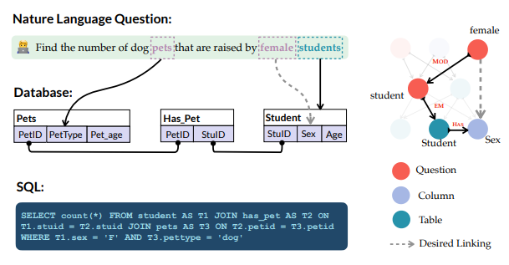
1.1.1. Illustration of cross-domain text-to-SQL challenge
The link is highly desired, i.e. between
the target column sex
and the token female
but extremely challenging for the model to capture;
especially when domain-specific data or effective rules is absent.

Slide 5
1.1.1. Illustration of cross-domain text-to-SQL challenge
However, this dilemma can be mitigated
by a multi-hop reasoning path:
(female MOD → student EM → Student HAS → Sex).
= Enable universal generalization of SQL for arbitrary databases.

Slide 6
1.2. Multi-hop Reasoning on T2S task
Specifically, Multi-hop reasoning is the ability to properly contextualize a user question against a given database
by simultaneously considering many
explicit relations or Structural representation (e.g., table/column relations specified by database schema)
implicit relations or Semantic representation (e.g., whether a phrase refers to a column or table).

Slide 7
1.3. Previous works
From the modeling perspective, there are two critical dimensions in T2S task:
How to effectively imbue relational structures (both explicit and implicit) in the form of graphs into neural networks = PICARD (@ later)
How to take the most advantage of pre-trained models (e.g. T5) = RAT-SQL (@ later)
NOTE : PICARD is non-invasive, thus can be plugin-ed into other models.

Slide 8
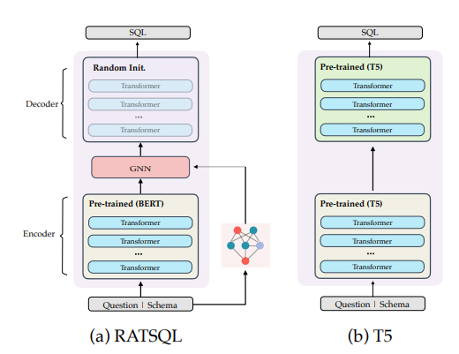
1.3.1 RAT-SQL
Only utilize pre-trained encoders (e.g., BERT)
and explicitly capture desired relations via specialized relation-aware models. (i.e. GNN-based module)
Use randomly initialized decoder

Slide 9
1.3.2. Deficiencies of previous works and breakthrough
More powerful encoder-decoder based pre-trained models are not exploited; i.e. randomly initialized decoder
Consequently, relational structures are accommodated at most; i.e. via GNN-module
Therefore, in this work,
the full encoder-decoder based pre-trained models (specifically T5)
and relation-aware encodings
are deeply coupled in favor of better domain generalization.

Slide 10
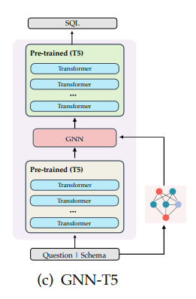
1.4. Warning on combined approach
GNN-T5 showed that simply adding a relational graph-based module in the middle of full T5 does not work very well on standard benchmarks.
Presumably, the deficiency comes from the middle graph-based modules breaking the original information flow inside T5.

Slide 11


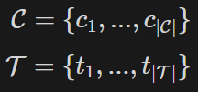

2. T2S task definition
A natural language question
with its corresponding database schemas
where represent columns and tables,
( refer to the number of columns and tables in each database respectively.)
Goal of T2S : Given a natural language question Q, to generate the corresponding SQL query y.

Slide 12
2.1. T5 input for T2S
The most canonical and effective format of inputs to T5 for T2S task is by PeteShaw (T5, Shaw et al. 2021) :
Unify
natural language questions Q
and database schema D
as a joint sequence as shown:

Slide 13




2.1. T5 input for T2S
: i-th token in the question
: represents j-th table in the D
: refers to the k-th column in the j-th table.
: the special column token in the database (for relation-aware encodings)
: the name of each database.

Slide 14
3. GRAPHIX-T5
Basic idea
GRAPHIX input
GRAPHIX layer
Semantic Representation
Structural Representation
GRAPHIX-T5 model

Slide 15
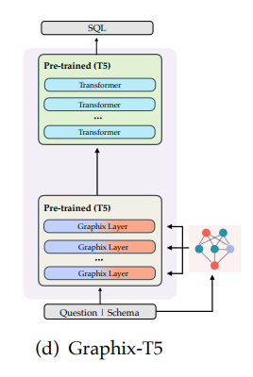
3.1. Basic idea
GRAPHIX constructs a new encoder by replacing the original T5 encoder with stacks of GRAPHIX layers.
In each GRAPHIX layer, the parameters of the semantic block are still initialized by T5, maintaining the contextualized encoding power of the pretraining.
c.f. randomly initialized encoder of GNN-T5

Slide 16
3.1. Basic idea
GRAPHIX layer simultaneously encodes a mixture of semantic and structural information.
Hidden states of inputs (composed by questions and databases) are modelled by contextualized semantic encoding
Structural representation is injected in each transformer layer using a relational GNN block. This GNN block enhances multi-hop reasoning through message passing, aiding capture explicit and implicit relations i.e. introduce structural inductive bias.

Slide 17
3.2. Input for GRAPHIX
Input for GRAPHIX is preprocessed through following procedures:
Contextual encoding
Graph construction
Bridge mode node matching

Slide 18
3.2.1. Contextual encoding
Same as T5 for T2S : create a joint sequence by unifying
natural language questions Q
and database schema D

Slide 19



3.2.2. Joint input as Graph
The joint input questions and schemas can be displayed as a heterogeneous graph
which consists of
three types of nodes
and multiple types of relations

Slide 20

3.2.2. Joint input as Graph
Specifically, for multiple types of relations
each r_i refers to a one-hop relation between nodes
and a multi-hop relation r^k is defined as a composition of one-hop relations:
as shown in the Figure 1 (where I refers to the length of each r^k (= |r^k| )

Slide 21
3.2.2.1. Categories of predefined relations
Inspired by previous works (RAT-SQL, S^2 SQL), we enumerated a list of pre-defined relations to connect nodes.
The relation sets can be divided into three main categories:
Schema relations
Schema linking relations
Question relations

Slide 22
3.2.2.1. Categories of predefined relations
Question relations
MODIFIER
and ARGUMENT
Question relations are implicit dependency relations between tokens in a question.
(@ Need to check the code for details.)

Slide 23
3.2.2.1. Categories of predefined relations
Schema relations
FOREIGN-KEY,
PRIMARY-KEY,
SAME-TABLE
Schema relations pertain to the particular explicit schema relations that the original T5 cannot obtain from linear inputs.

Slide 24
3.2.2.1. Categories of predefined relations
Schema linking relations
EXACT-MATCH,
PARTIALMATCH,
and VALUE-MATCH
Schema linking relations are implicit linking relations between question and schema nodes.
A new type of relation BRIDGE is introduced. (@ yet reading)

Slide 25
4. GRAPHIX layer
GRAPHIX layer plays a role as an Encoder part of the Encoder-Decoder architecture, replacing the original encoder of the pretrained T5.
The GRAPHIX layer is designed to integrate these informations:
Semantic information obtained from each transformer block
Structural information obtained from relational graph neural network (GNN) block.

Slide 26

4. GRAPHIX layer
Encoder part of the GRAPHIX-T5 can be formalized as
theta : Parameters of Transformer blocks for semantic information
psi : Parameters of GNN blocks for structural information
The core idea of GRAPHIX is to migrate parameters theta from original T5 encoder as the initial parameters of semantic transformer block of the GRAPHIX layer,
in order to preserve the pre-trained semantic knowledge of the original T5.

Slide 27
4.1. GNN blocks
In each GRAPHIX Layer, structural representations are produced through the relational graph attention network, RGAT (Wang et al. 2020b) over the pre-defined question-schema heterogeneous graph.
For RGAT (Relational Graph Attention Transformer), various node embeddings initialization strategies could be implemented;
GRAPHIX initialized with their semantic representations.

Slide 28
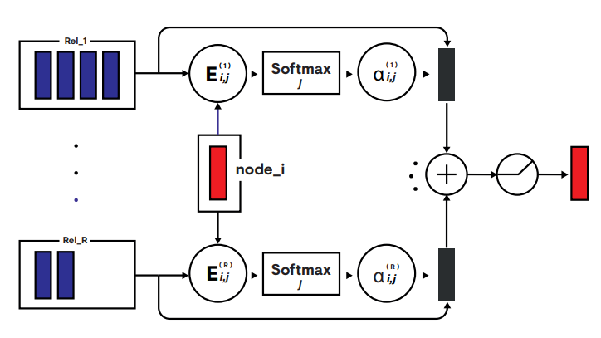
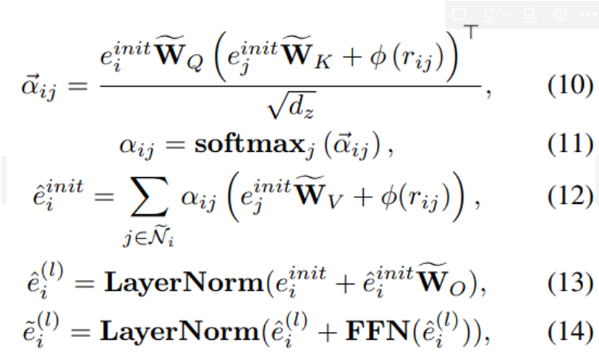
4.1. GNN blocks
Formally, given initial node embedding e^{init}_i, for
i-th node
and its j-th neighbor e^{init}_j,
which are linked by specific types of relations, (pre-defined relations categories)
it can be computed through:
(@ more in RGAT)

Slide 29

4.2. Joint Representation
After computing representations from both semantic and structural space,
the l-th GRAPHIX Layer employs a mixture of semantic and structural information to enable information integration as following:
Finally, this joint representation is inputed into decoder part of the pretrained T5.

Slide 30
4.3. Ablation
Although GRAPHIX layer can possibly be in both encoder and decoder, adding GRAPHIX layers to the decoder does not lead to any improvements;
Decoder is an autoregressive model, which only considers the history tokens when generating the current token.
However, GRAPHIXT5 may disrupt this characteristic, as it can forecast the information of future tokens by global linking (i.e. message passing)
Therefore, currently the best tactic is to only incorporate GRAPHIX layers into the encoder.

Slide 31
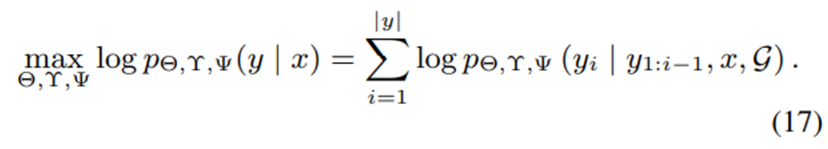
4.4. Training
Similar to original T5, we also follow a common fine-tuning strategy:
The whole training framework is to optimize the following log-likelihood.

Slide 32
4.4. Training
We evaluate our effectiveness of GRAPHIXT5 across two main versions:
T5-Large with approximately 800M parameters
and T5-3B, with more than 3 Billion parameters literally.
All experiments are conducted on one NVIDIA Tesla A100.

Slide 33
5. Evaluation metrics
In T2S task, these are the two standard metrics:
Exact Match (EM)
Execution Accuracy (EX)
EM can evaluate how much a generated SQL is comparable to the gold SQL.
EX can reflect whether a predicted SQL
is (syntactically) valid
and returns the exact result as desired by users.

Slide 34
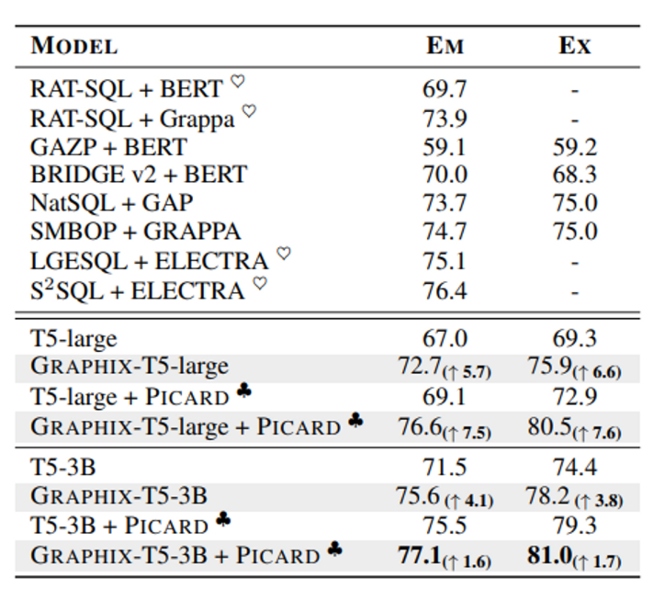
5.1. Result
Exact match (EM) and execution (EX) accuracy (%) on SPIDER development set.
♥ means the model does not predict SQL values. (@ maybe verbal/ pseudo code output)
♣ means the model uses the constrained decoding PICARD.
↑ is an absolute improvement.

Slide 35
5.1. Result
GRAPHIX-T5-3B with a constrained decoding module PICARD achieves the state-of-the-art.
This indicates that
the structural generalization capability of the GRAPHIX layer is crucial for T5, such a text-to-text PLM,
to perform the text-to-SQL task.

Slide 36
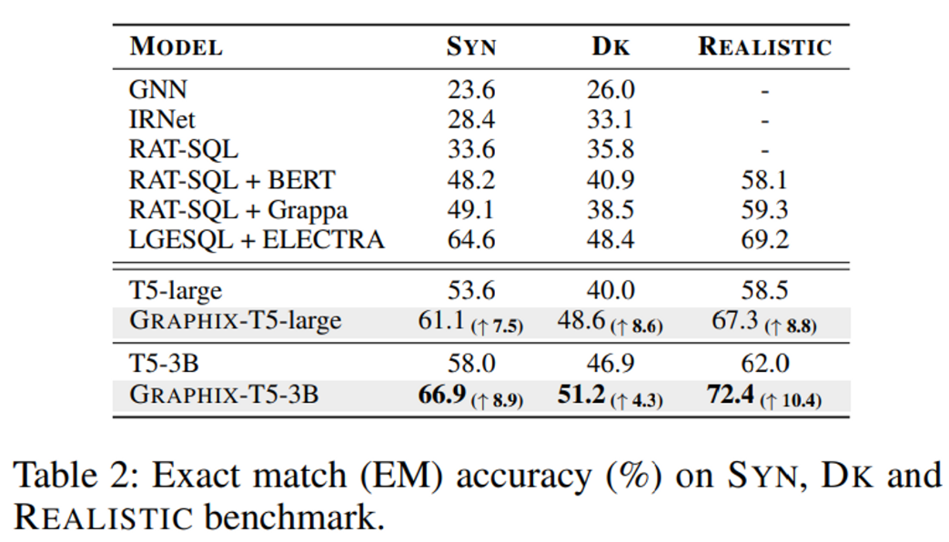
5.2. Zero-shot Results
GRAPHIX-T5 showed much superior robustness
when it confronts with more challenging and closer to realistic evaluations
in SYN, DK, REALISTIC benchmarks.

Slide 37
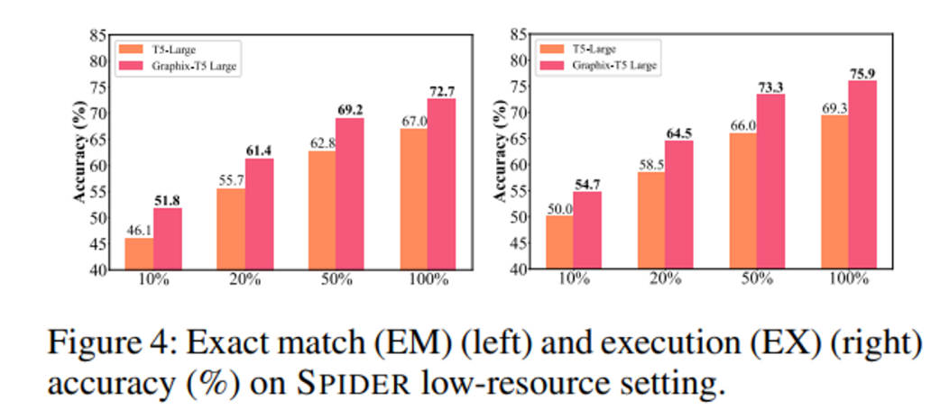
5.3. Results on Low-resource Settings

Slide 38
5.4. Further
Though we only focus on text-to-SQL parsing in this work,
we believe that the general methodology of GRAPHIX-T5 can be extended to structured knowledge grounding tasks,
e.g.,
TableQA (Pasupat and Liang 2015),
Data-to-text (Nan et al. 2021)
and KBQA (Talmor and Berant 2018).

Slide 39
6.1. Proposing method 1
Instead of training (fine tuning) the entire model at once,
training on two steps:
Training the complete model (just as previous) using Question + SQL
Training the GNN module alone using schema only

Slide 40
6.1. Proposing method 1
Because amount of training data for SQL is limited, i.e. collected from real world application or human-generated
the model may not train enough structural information of the database to fine tune on.
Thus, generate data from database schema as meaning of augmentation and further train the GNN module.
Hopefully, this can reinforce the structural recognition of the model.

Slide 41
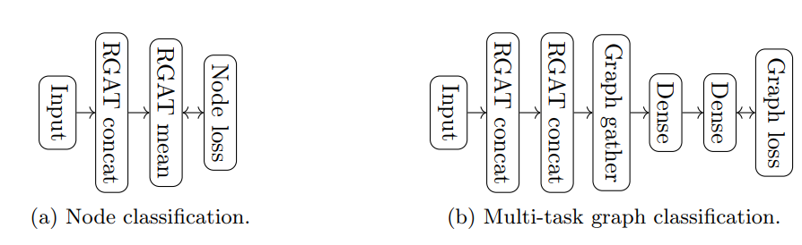
6.1. Proposing method 1
Specifically:
the GNN module (RGAT) is trained on Node Classification task with question(predefined relation categories)-schema heterogeneous graph.
Here, schema info can simply be extracted from given schema from users.
Thus, set relation info first, and make schema info based on that relation info.
Example: For Schema relations of SAME-TABLE, constraint to only extract schema within the same table.
Or use following data synthesis method.

Slide 42
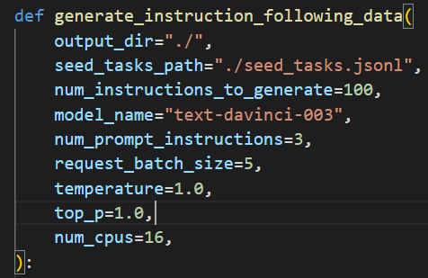
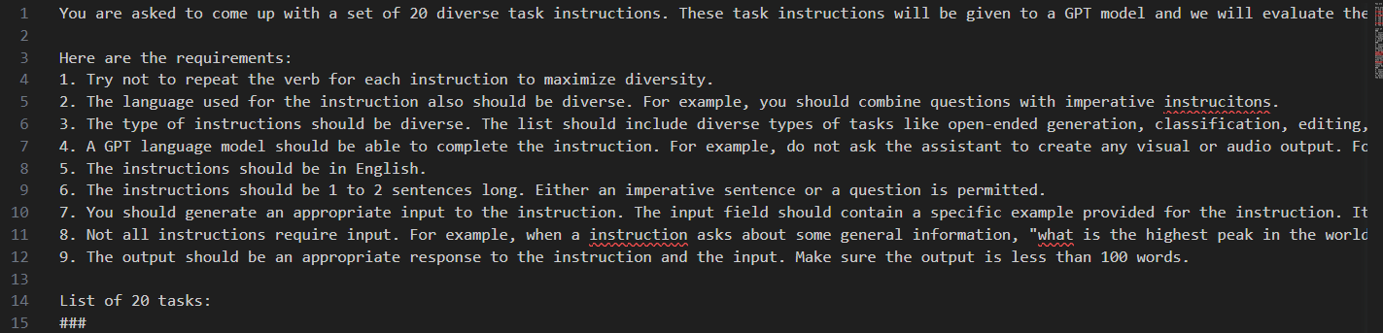
6.2. Data synthesis
LLMs are utilized to generate dataset:
Template instruction is given to LLM
and LLM generates dataset based on given instruction.

Slide 43
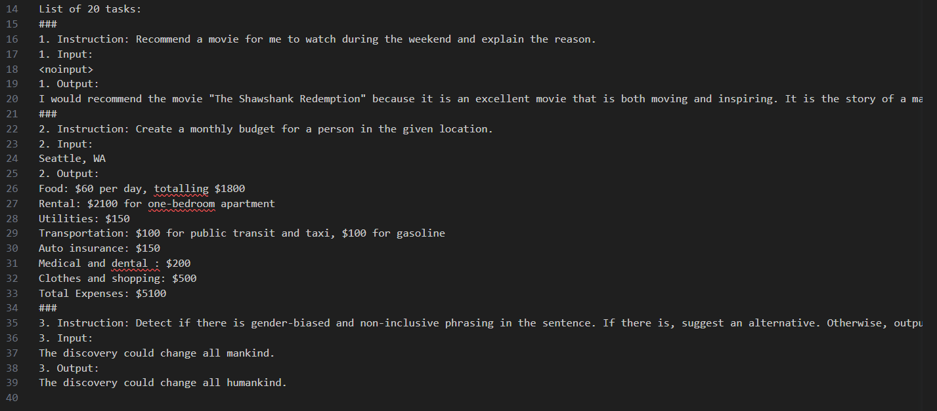
6.2. Data synthesis

Slide 44
6.2. Data synthesis
Generated data :
Variables:
Question : Generated or “reverse translated” from LLM (e.g. T5, GPT …)
Schema
Response:
Schema element (table name, column name, …)
“Reverse translated” as we reversely generate question “from” SQL.

Slide 45
6.2.1. Procedure
Randomly generate SQL statements
Ask LLM to “translate” generated SQL statements into NL.
Make dataset with (NL, schema) - [schema info for SQL].
Example:
SELECT count(*) FROM car_list WHERE car_list.manufacturer = “Porsche”
“Find the number of car models made by Porsche.”
( “Find the number of car models made by Porsche.”, {schema} ) - [car_list, car_list.manufacturer]

Slide 46
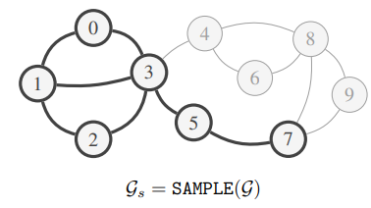
6.3. For large database
For large database, the graph for structural information in schema can be too large and complex;
leading to overfitting or neighboring explosion.
To constrain such, apply GraphSaint to GNN-module to restrict the number of neighbors during the multi-hop relation training.

Slide 47
6.4. Expecting benefits
1. Reinforce GNN module.
Contrast to semantic module (T5 encoder), which is already trained enough with vast sized language datasets, the structural module (GNN) has relatively smaller amount of data (data with Question-SQL pair)
Such data augmentation can help model further learning structural information.
2. Aid end users fine tuning on their target database
Since end users may have little or no data for fine tuning, generating data from schema automatically can improve user experience.

Slide 48
6.4. Expecting benefits
3. Effectively leverage LLM for data generation
Can leverage powerful LLM in data generation, removing human effort from the process and still gaining good quality of data.
4. Help fine tuning on even large database
Using GraphSaint, prevent too much training cost, yet training well on large complex database schema.

